Slide 1




The impact of Covid-19 around the world: How does the UK compare?
Hans H. Sievertsen
#FFTCONF22

Slide 2

Goal
Provide an overview of COVID-19 induced school closures around the world in comparison to the UK.
Disclaimer
I will not take a stance on whether school closures were and/or are the right measures.
Data
Sources: Own calculations based on data from UNESCO. Partial closures: Certain areas/grades or reduced schooling.
Full closures: Government-mandated closures affecting at least 80% of the enrolled.
#FFTCONF22

Slide 3
21 months into the pandemic
British school children experienced 27w of partial or full school closures.
#FFTCONF22

Slide 4
21 months into the pandemic
British school children experienced 27w of partial or full school closures.
Ugandan school children experienced 81w of partial or full school closures.
#FFTCONF22

Slide 5
21 months into the pandemic
British school children experienced 27w of partial or full school closures. On average they complete 13.2y of education.
Ugandan school children experienced 81w of partial or full school closures. On average they complete 6.2y of education.
#FFTCONF22

Slide 6
21 months into the pandemic
British school children experienced 27w of partial or full school closures. On average they complete 13.2y of education. COVID-19 disrupted ≈ 5% of their schooling.
Ugandan school children experienced 81w of partial or full school closures. On average they complete 6.2y of education. COVID-19 disrupted ≈ 33% of their schooling.
#FFTCONF22

Slide 7
21 months into the pandemic
British school children experienced 27w of partial or full school closures. On average they complete 13.2y of education. COVID-19 disrupted ≈ 5% of their schooling.
That is a lot. For many children it will be a lot higher!
Ugandan school children experienced 81w of partial or full school closures. On average they complete 6.2y of education. COVID-19 disrupted ≈ 33% of their schooling.
That is alarming!
#FFTCONF22

Slide 8
The big picture
School disruptions Feb 2020-Oct 2021
#FFTCONF22

Slide 9
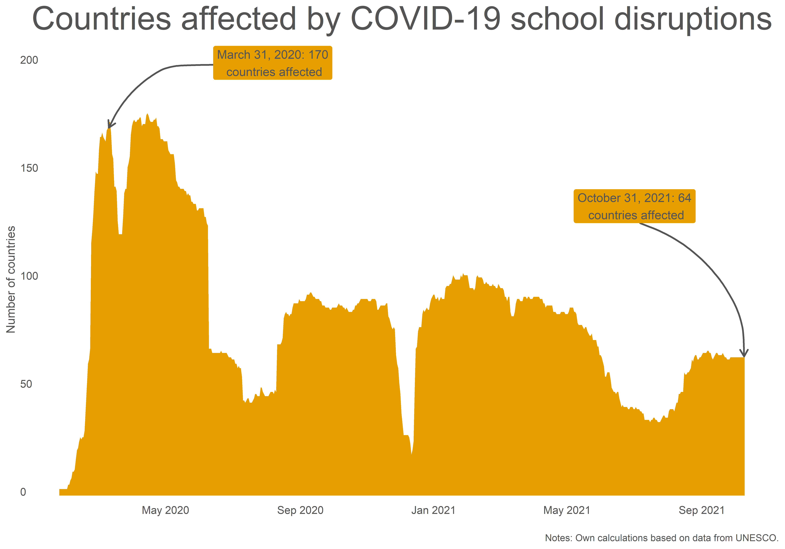
#FFTCONF22

Slide 10
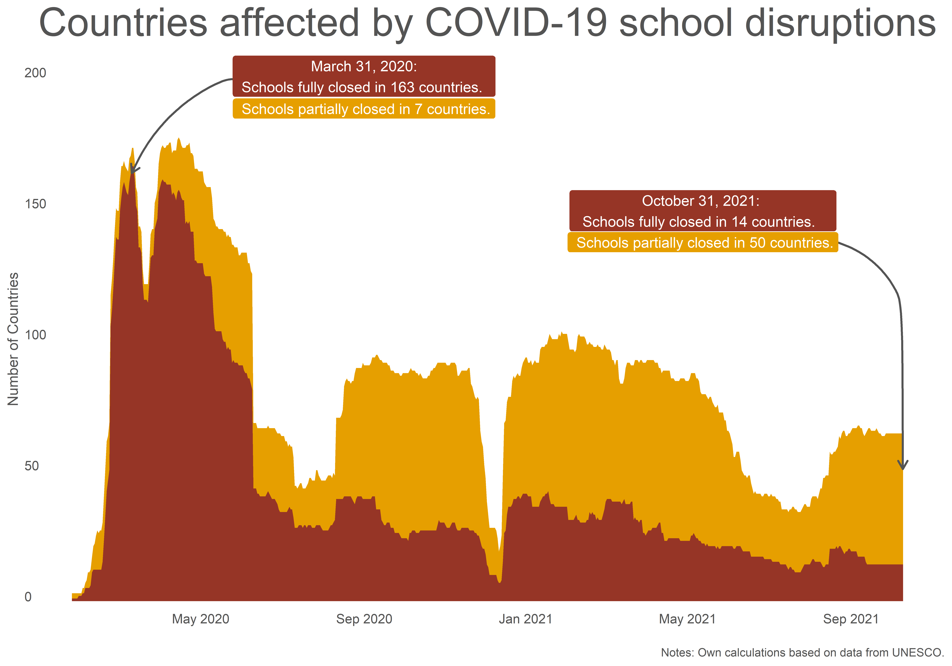
#FFTCONF22

Slide 11
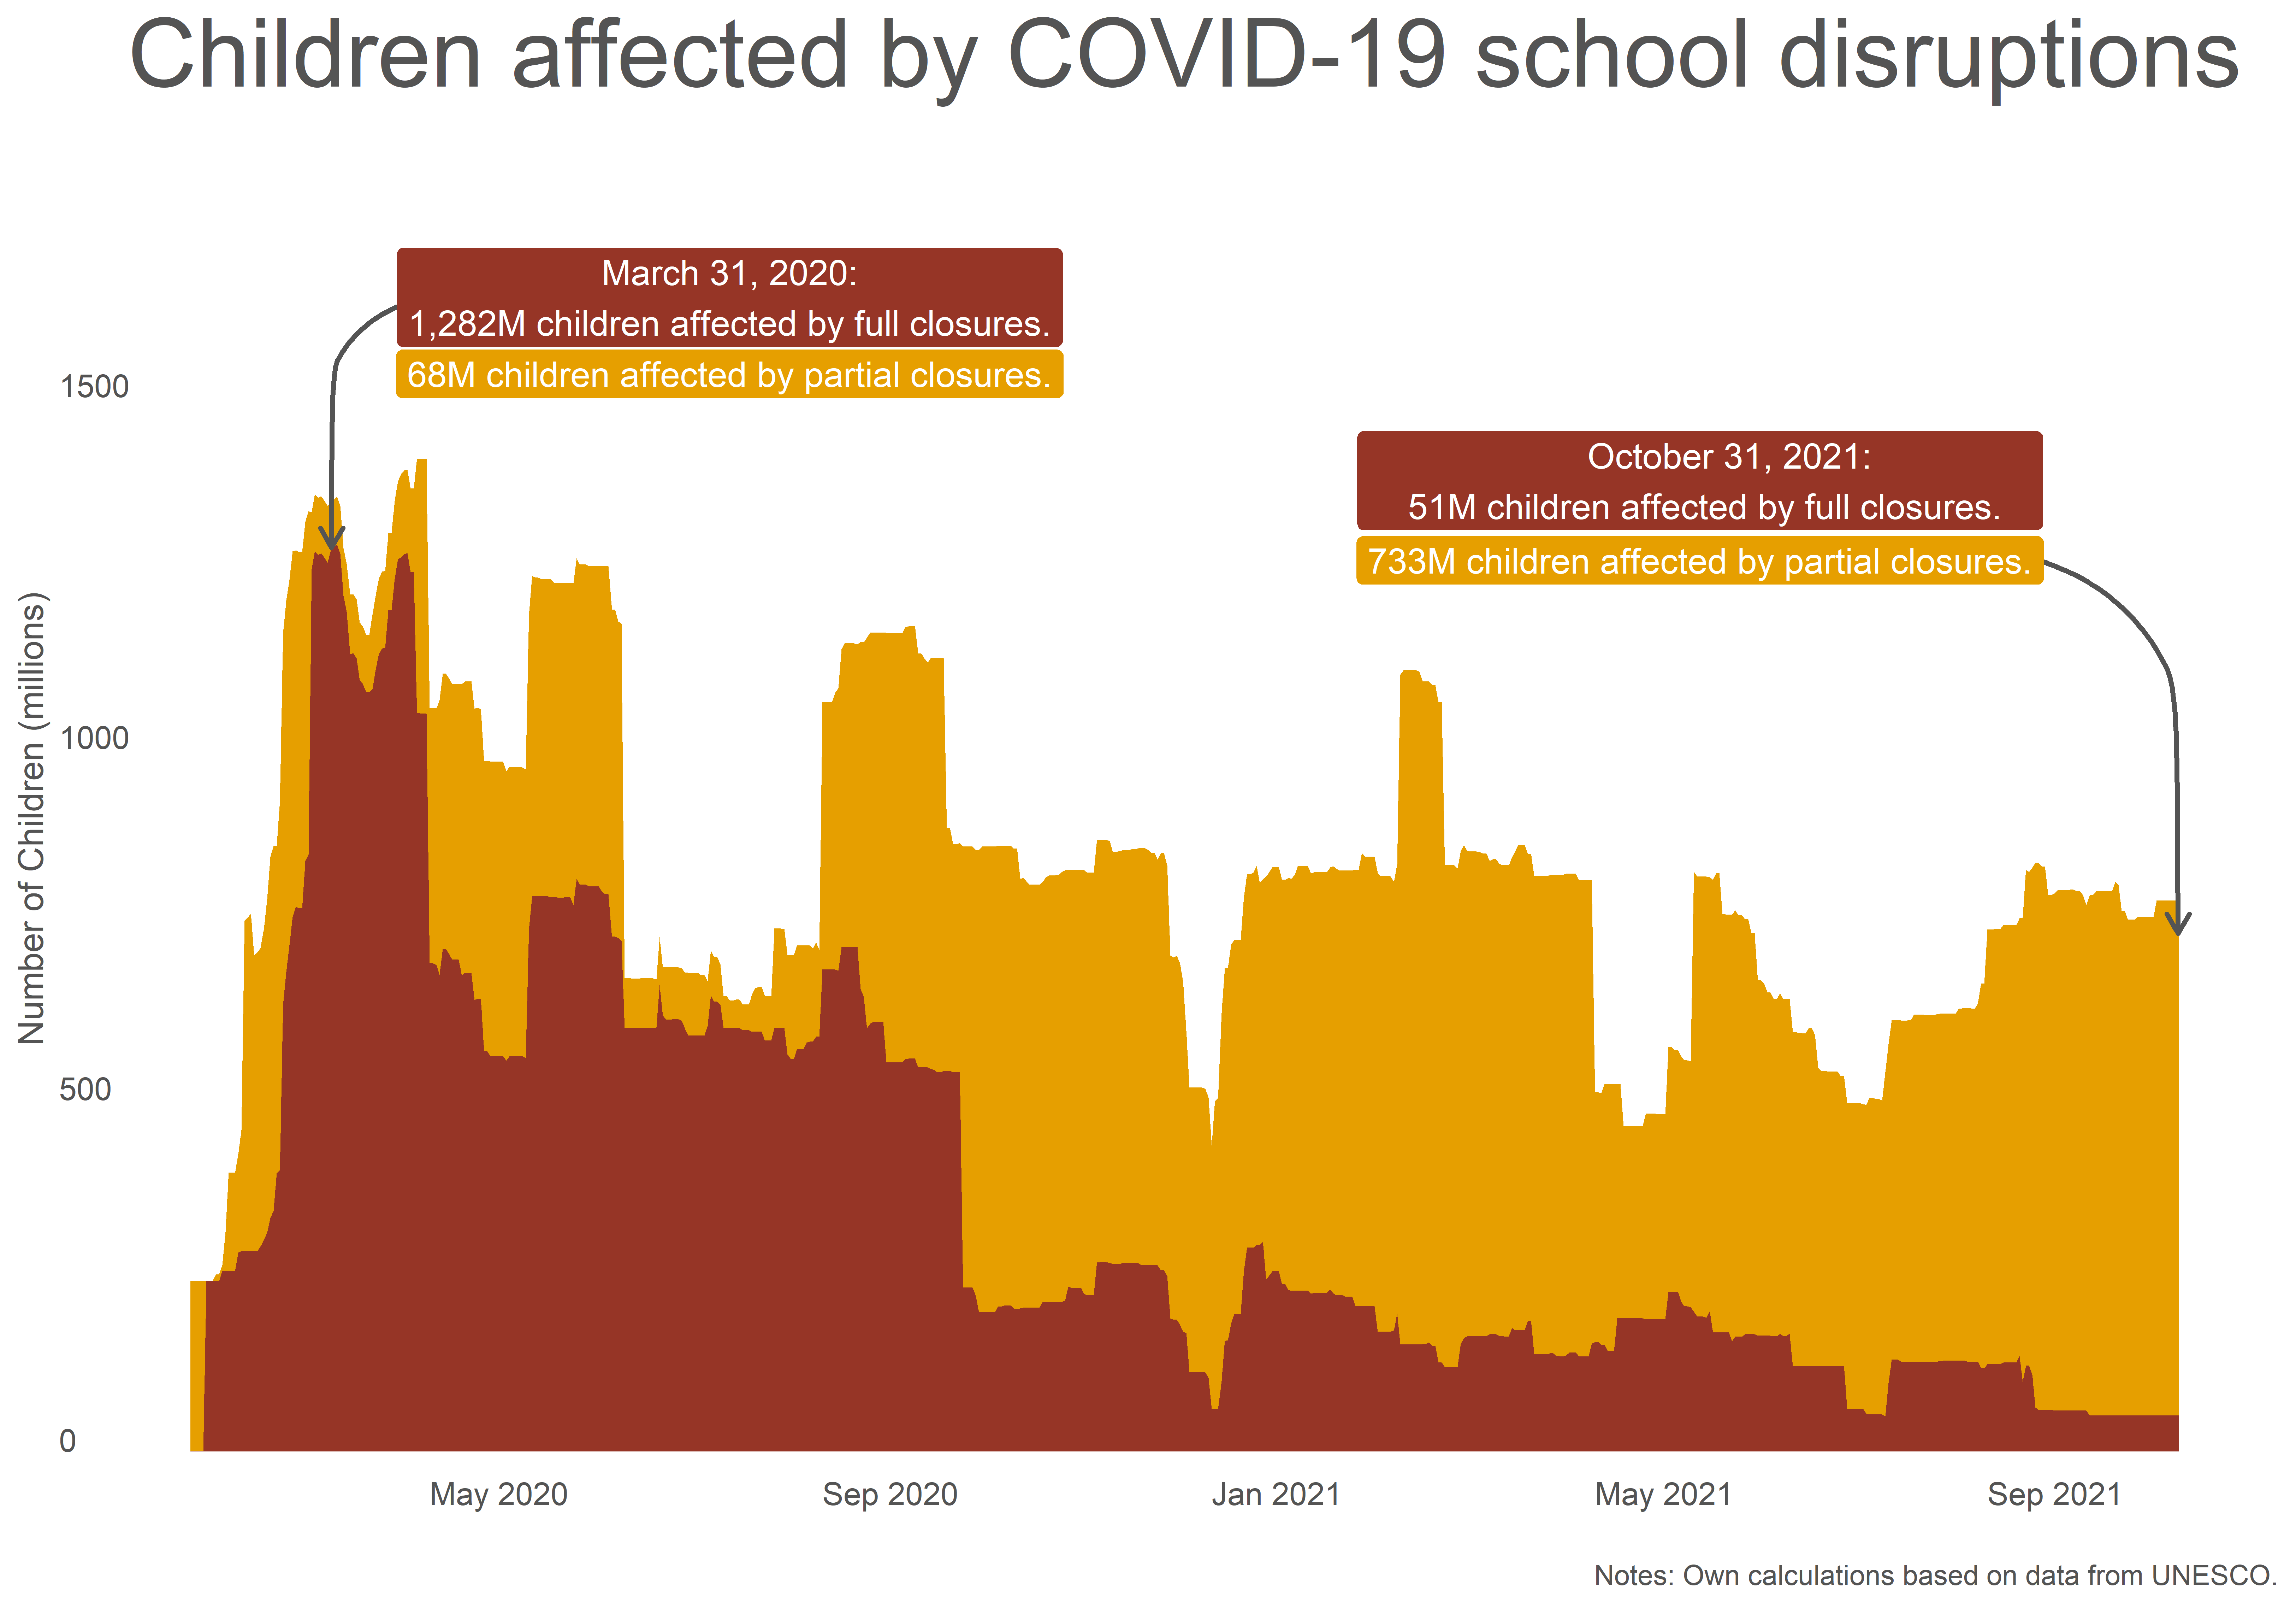
#FFTCONF22

Slide 12
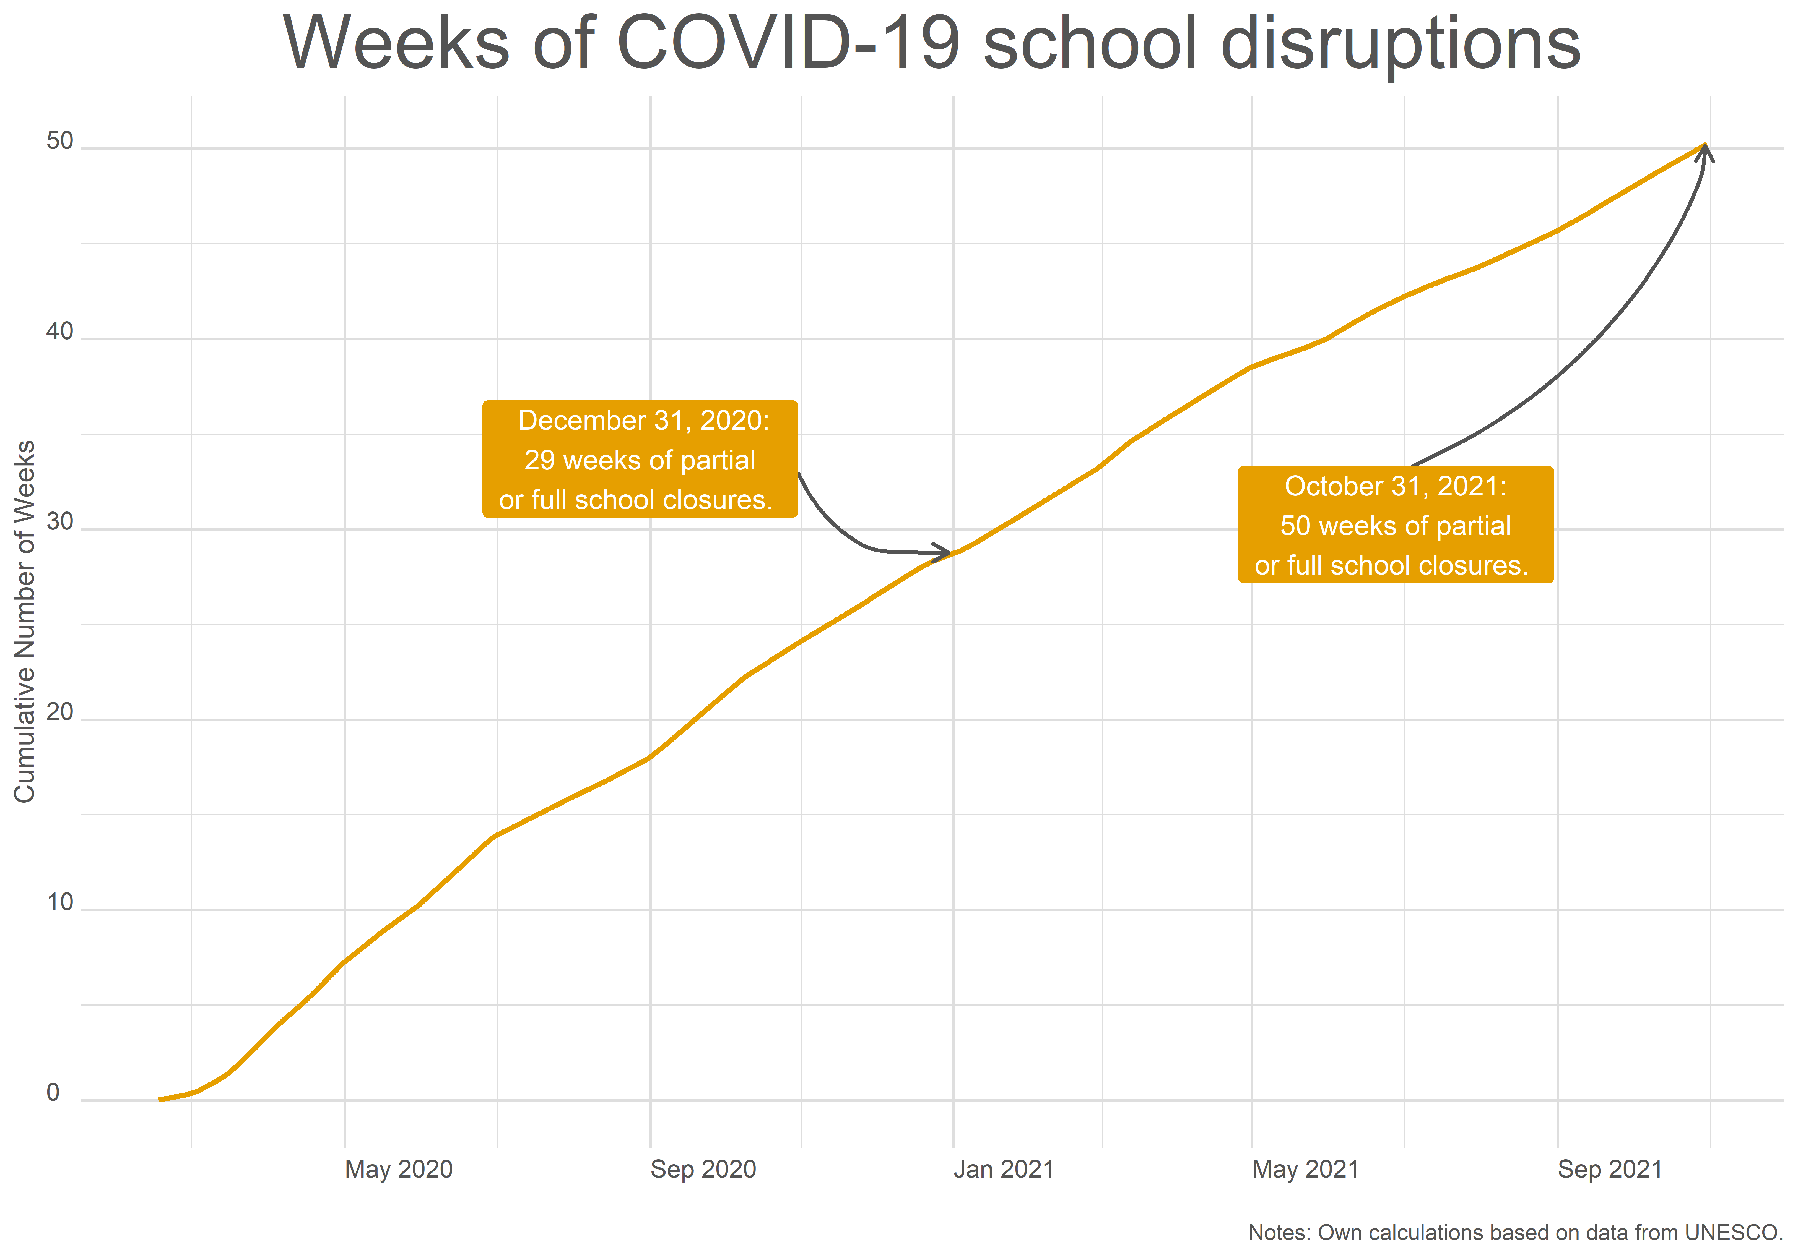
#FFTCONF22

Slide 13
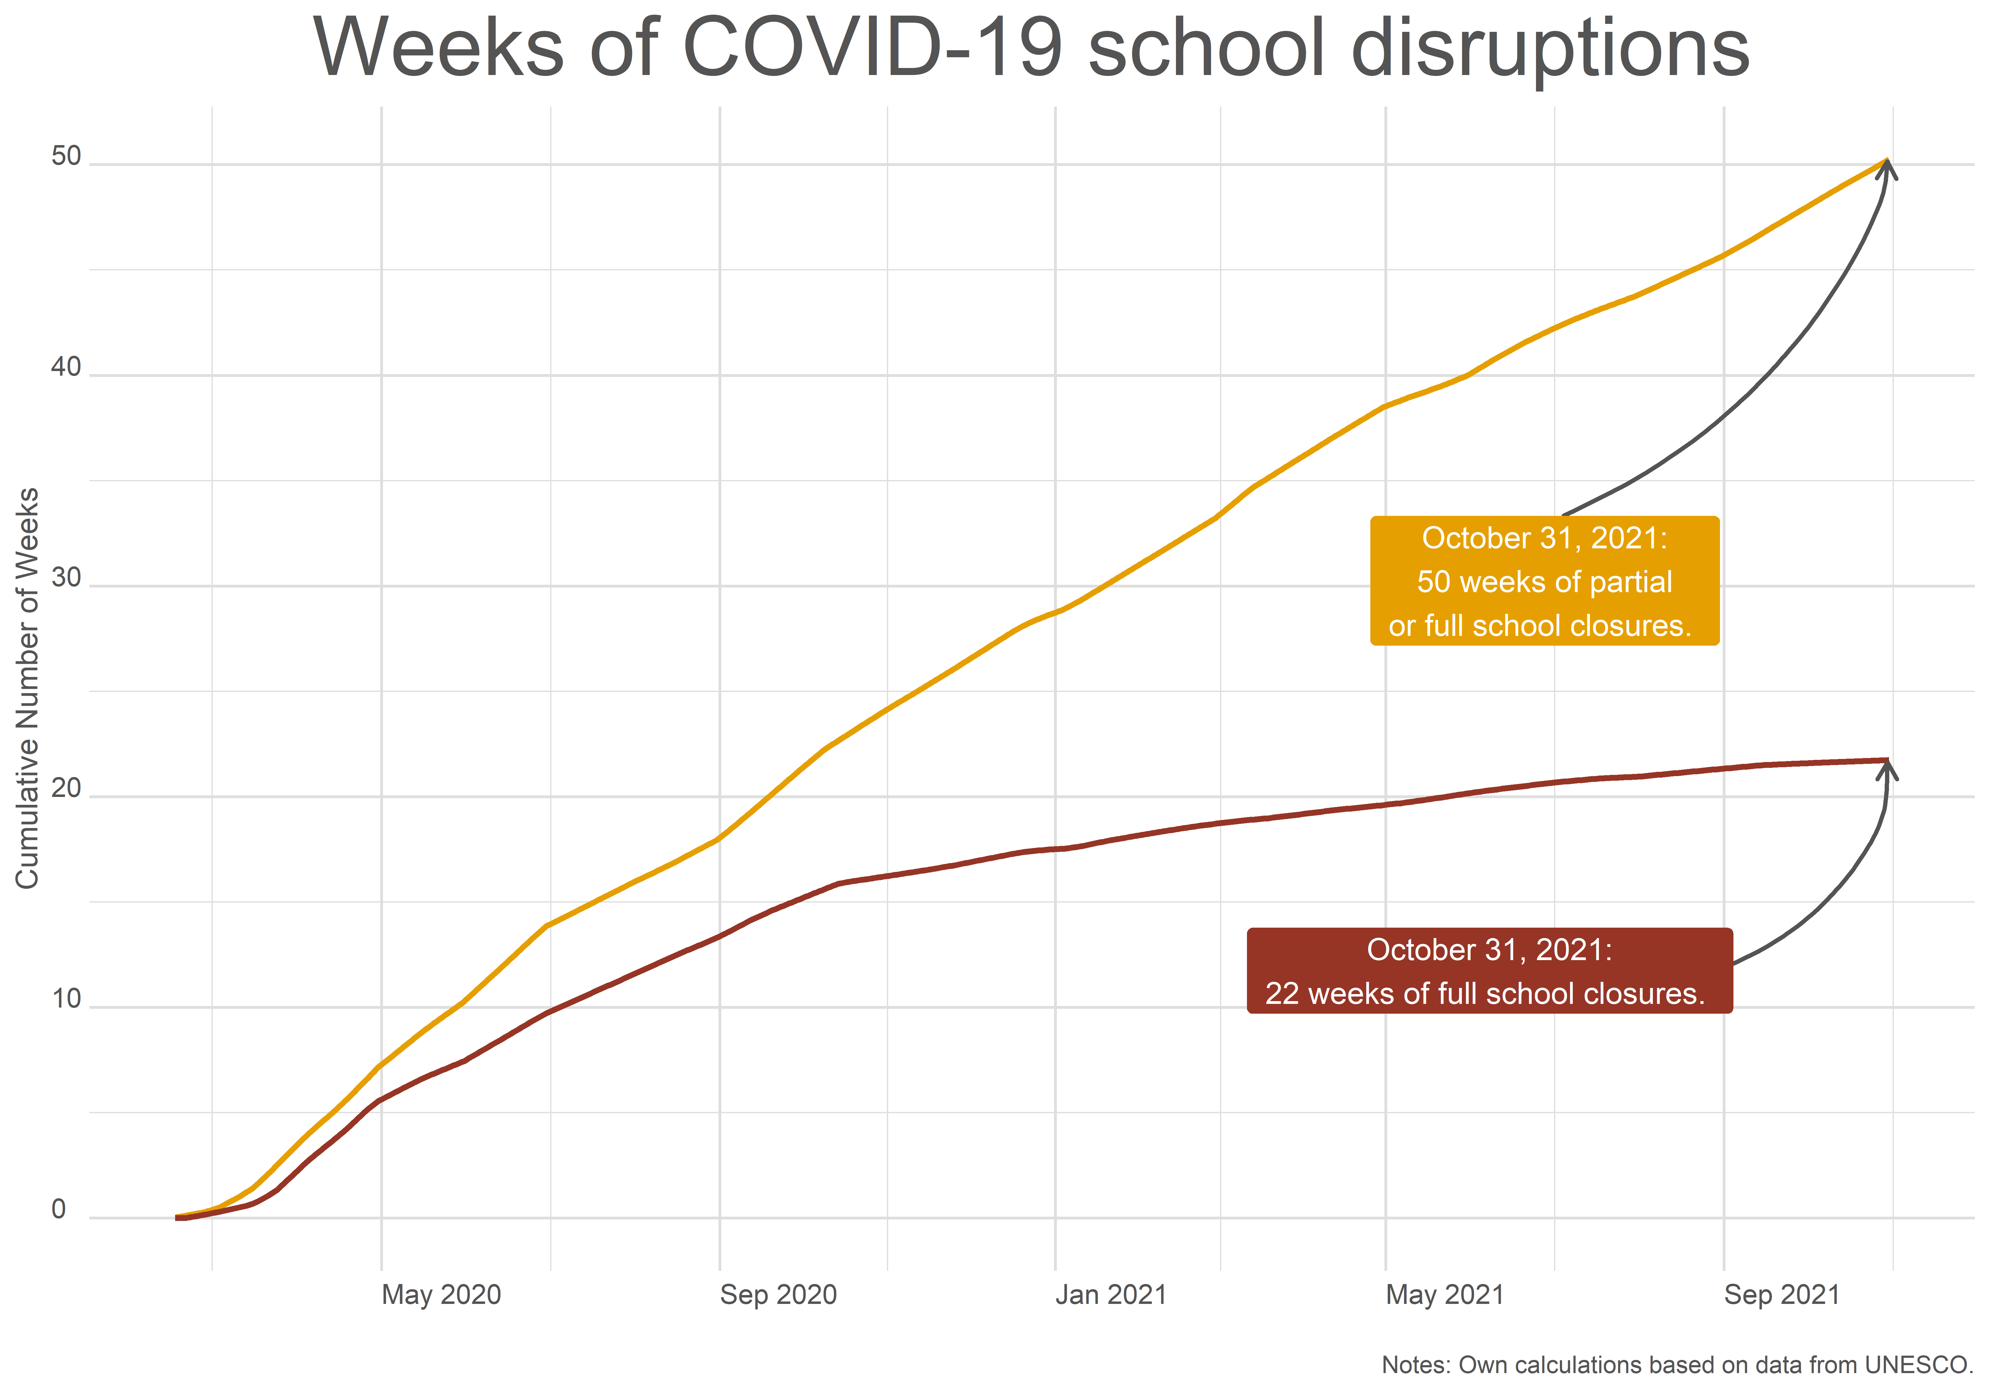
#FFTCONF22

Slide 14
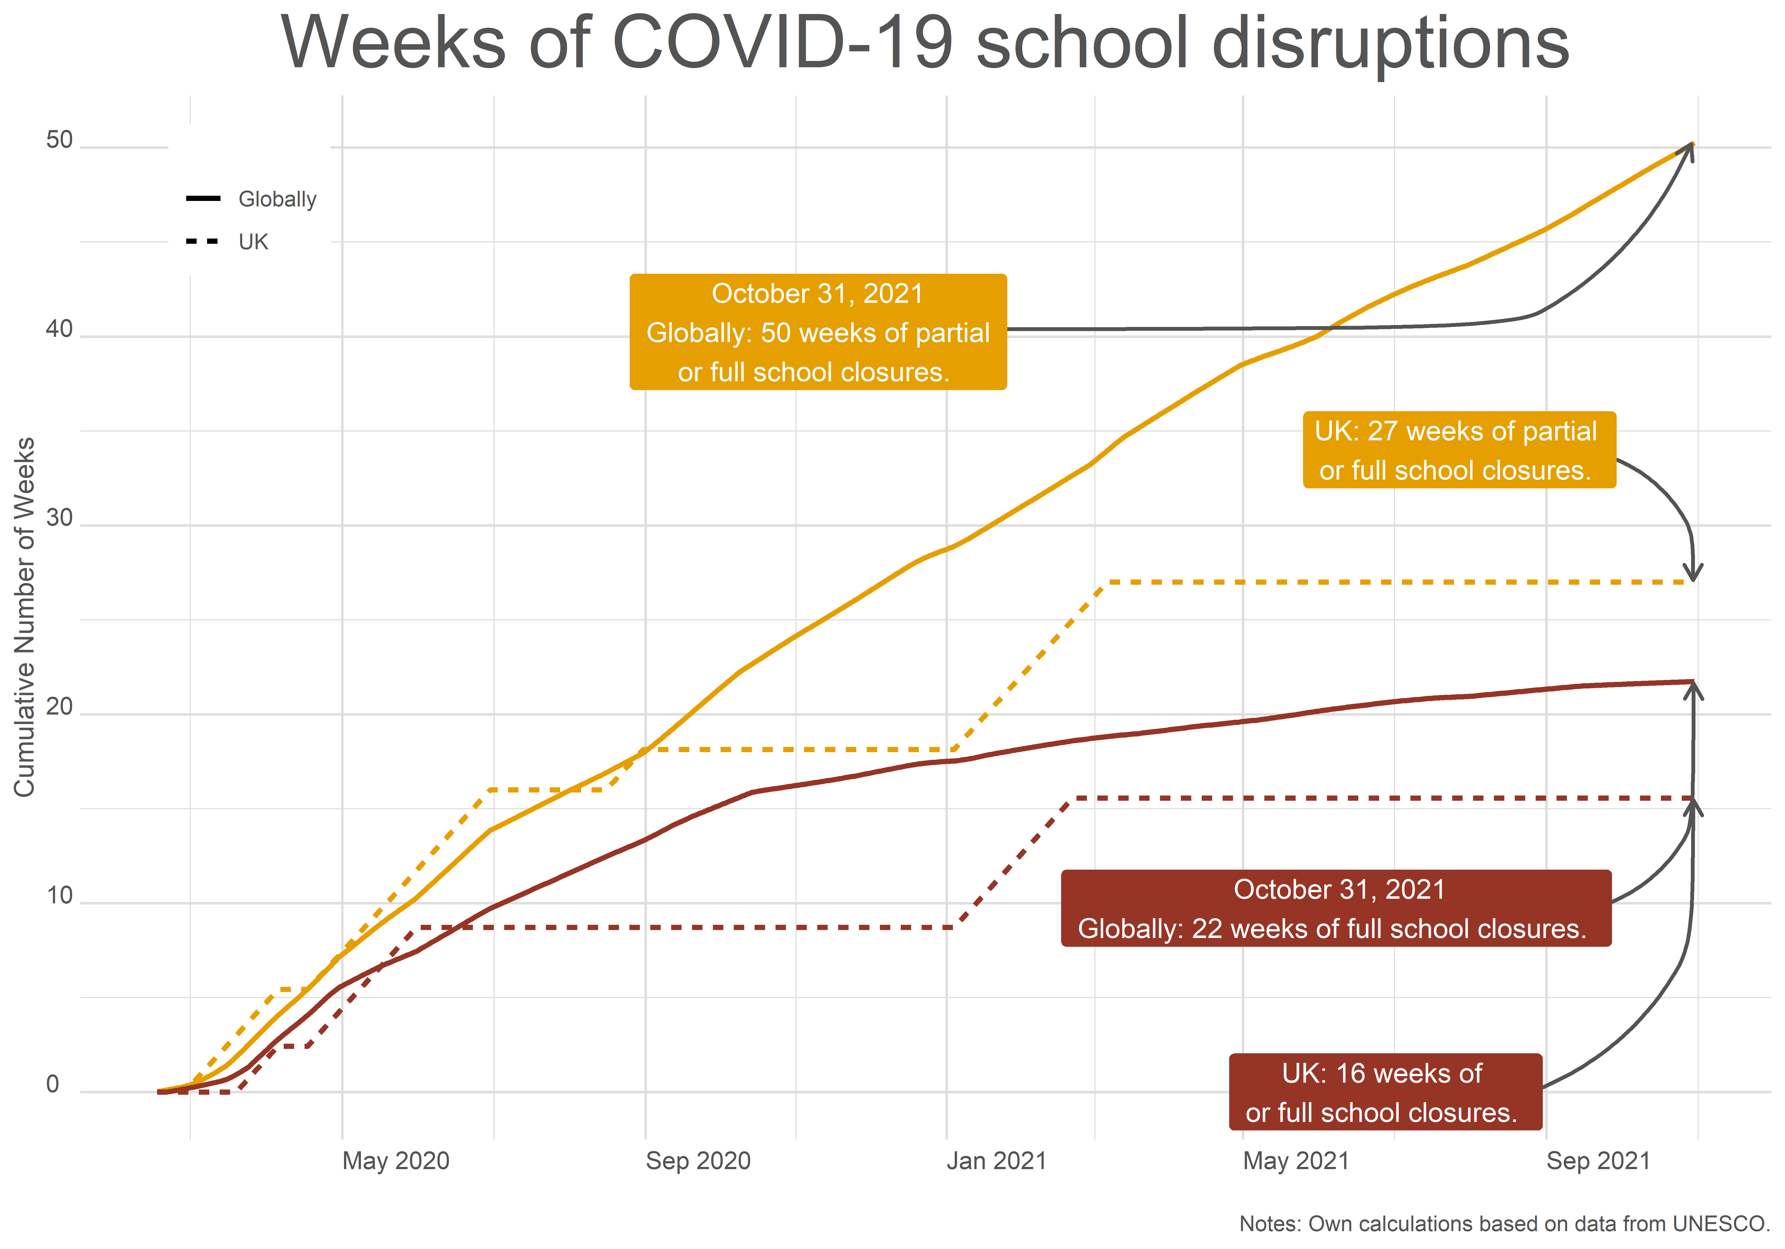
#FFTCONF22

Slide 15
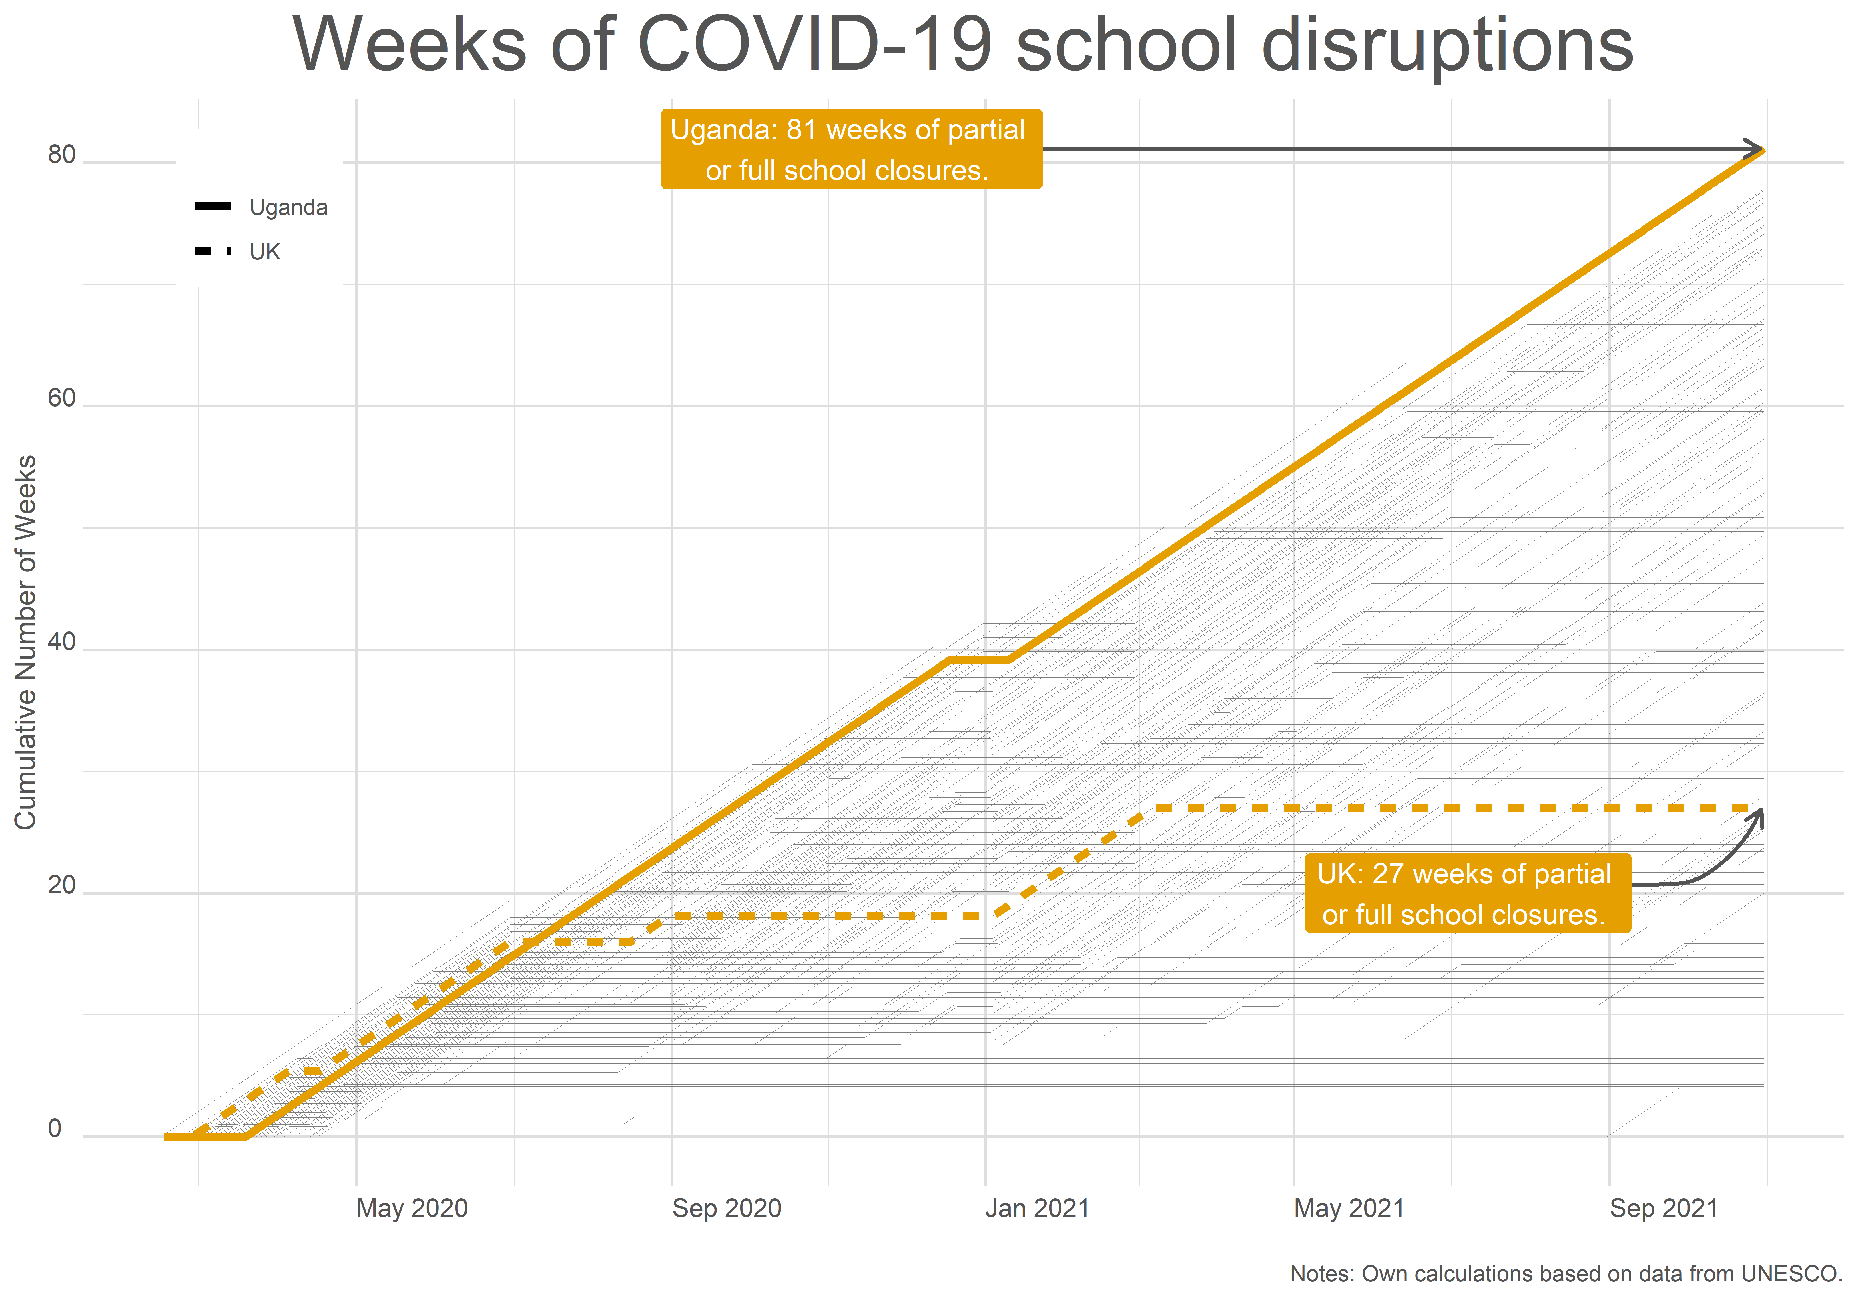
#FFTCONF22

Slide 16
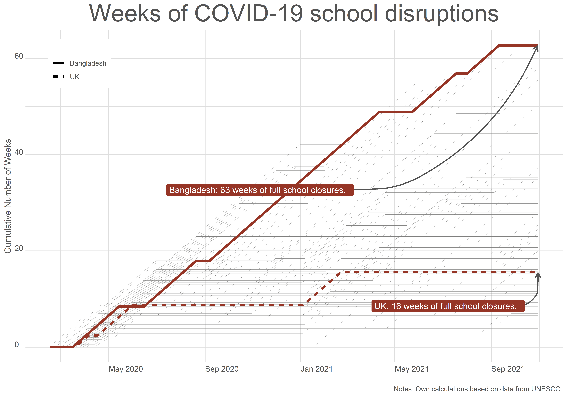
#FFTCONF22

Slide 17
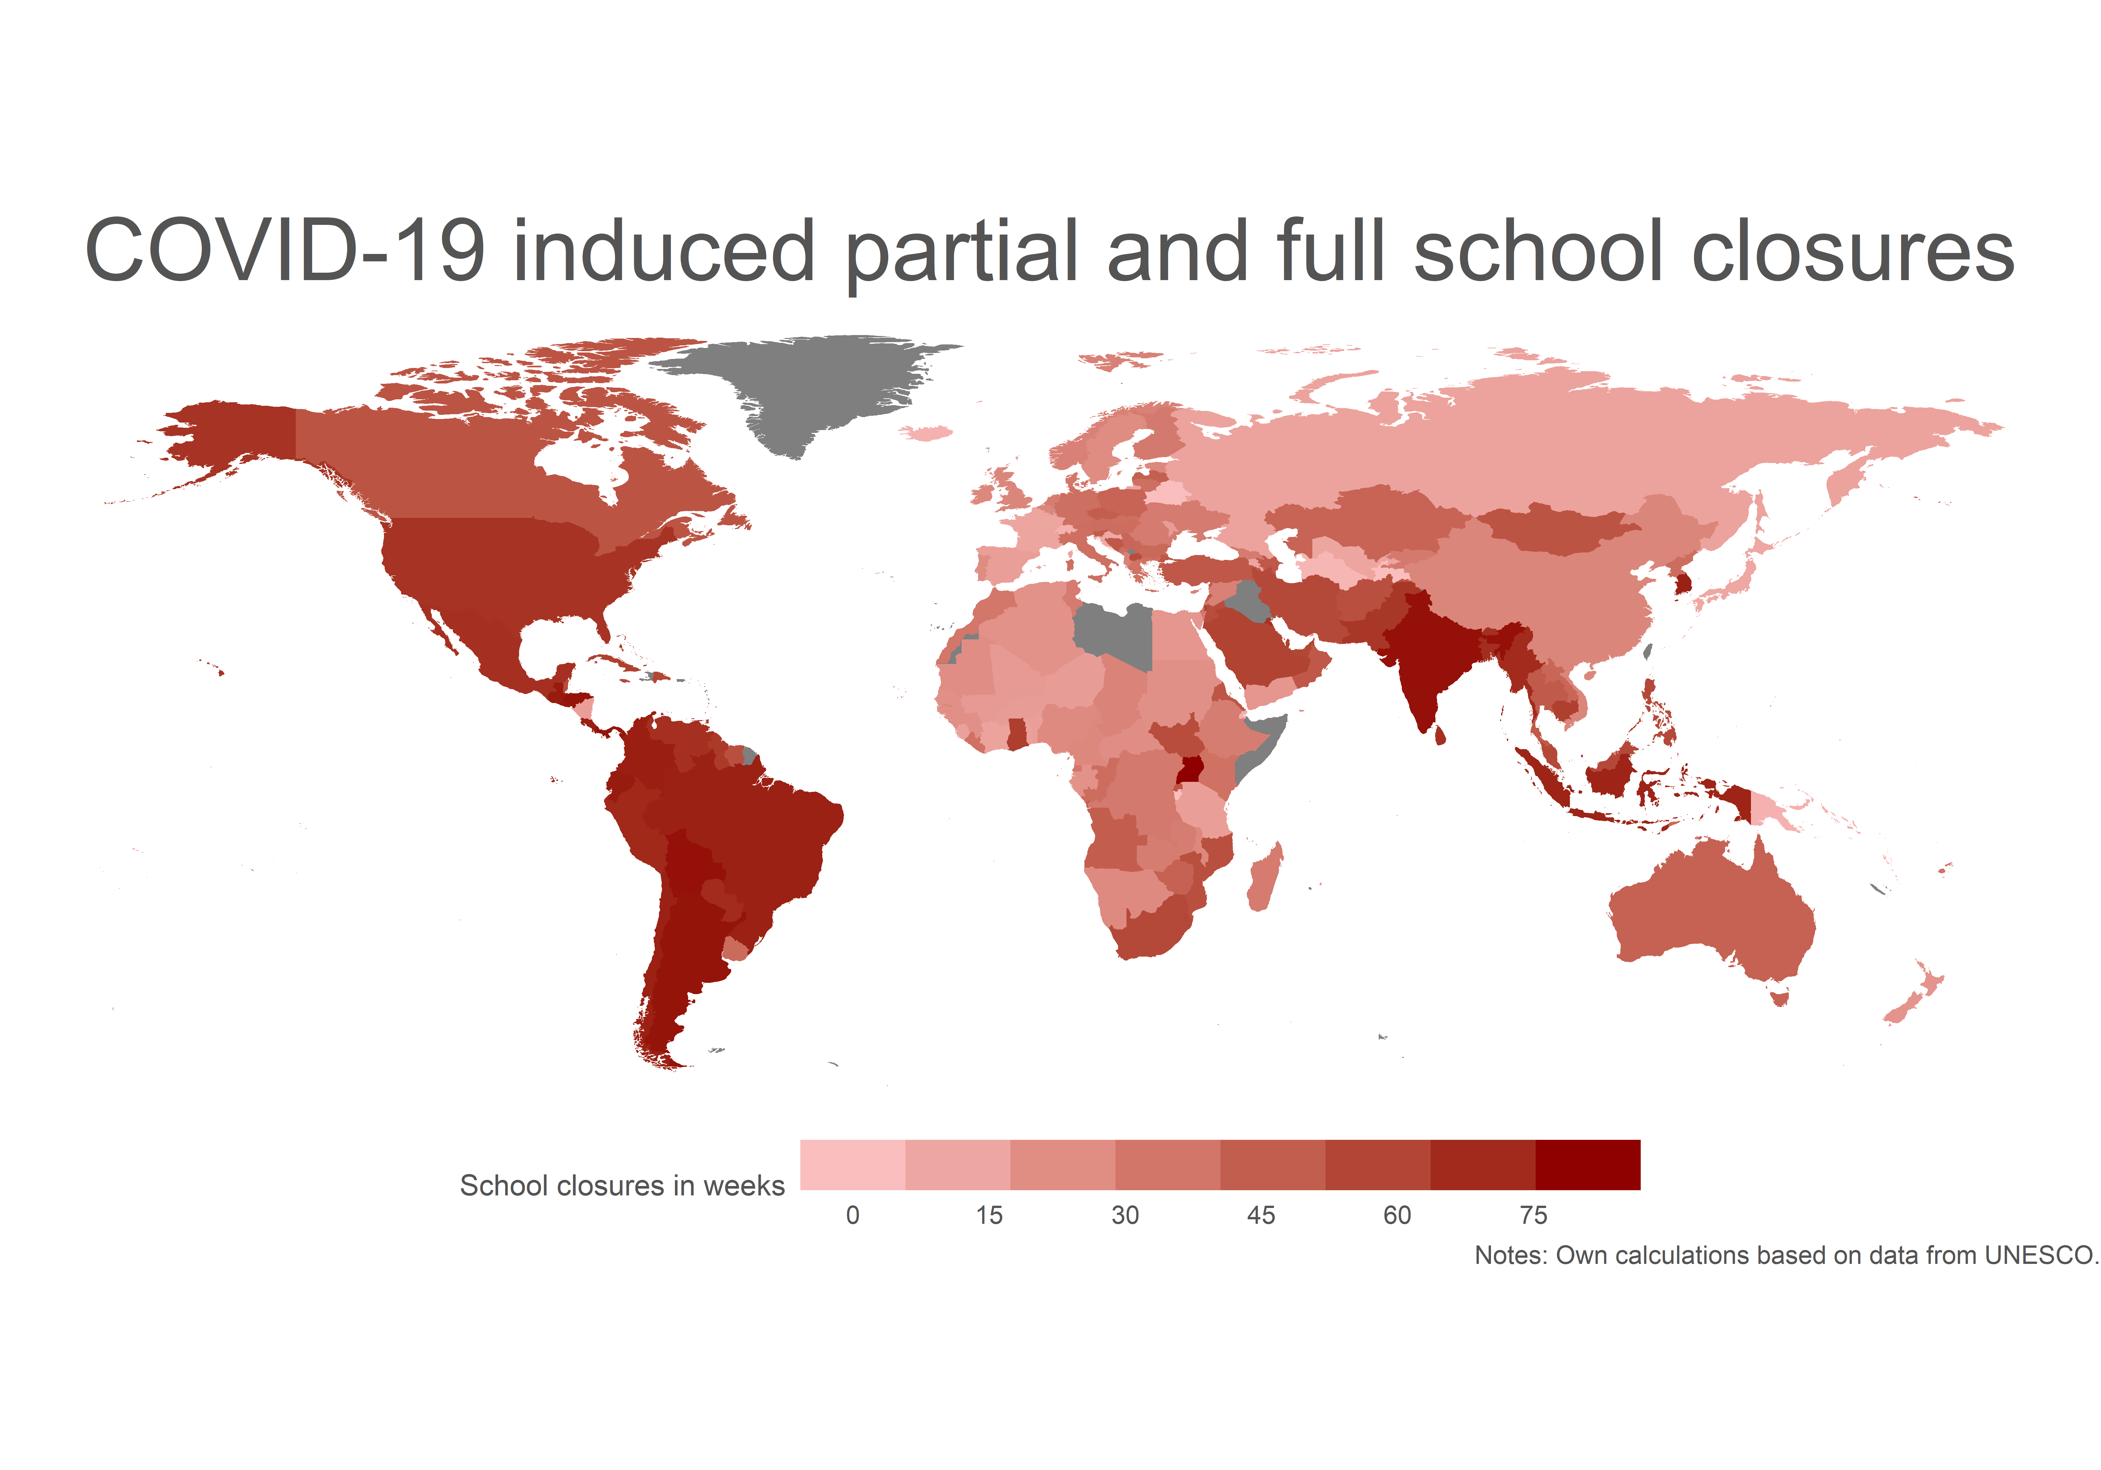
#FFTCONF22

Slide 18
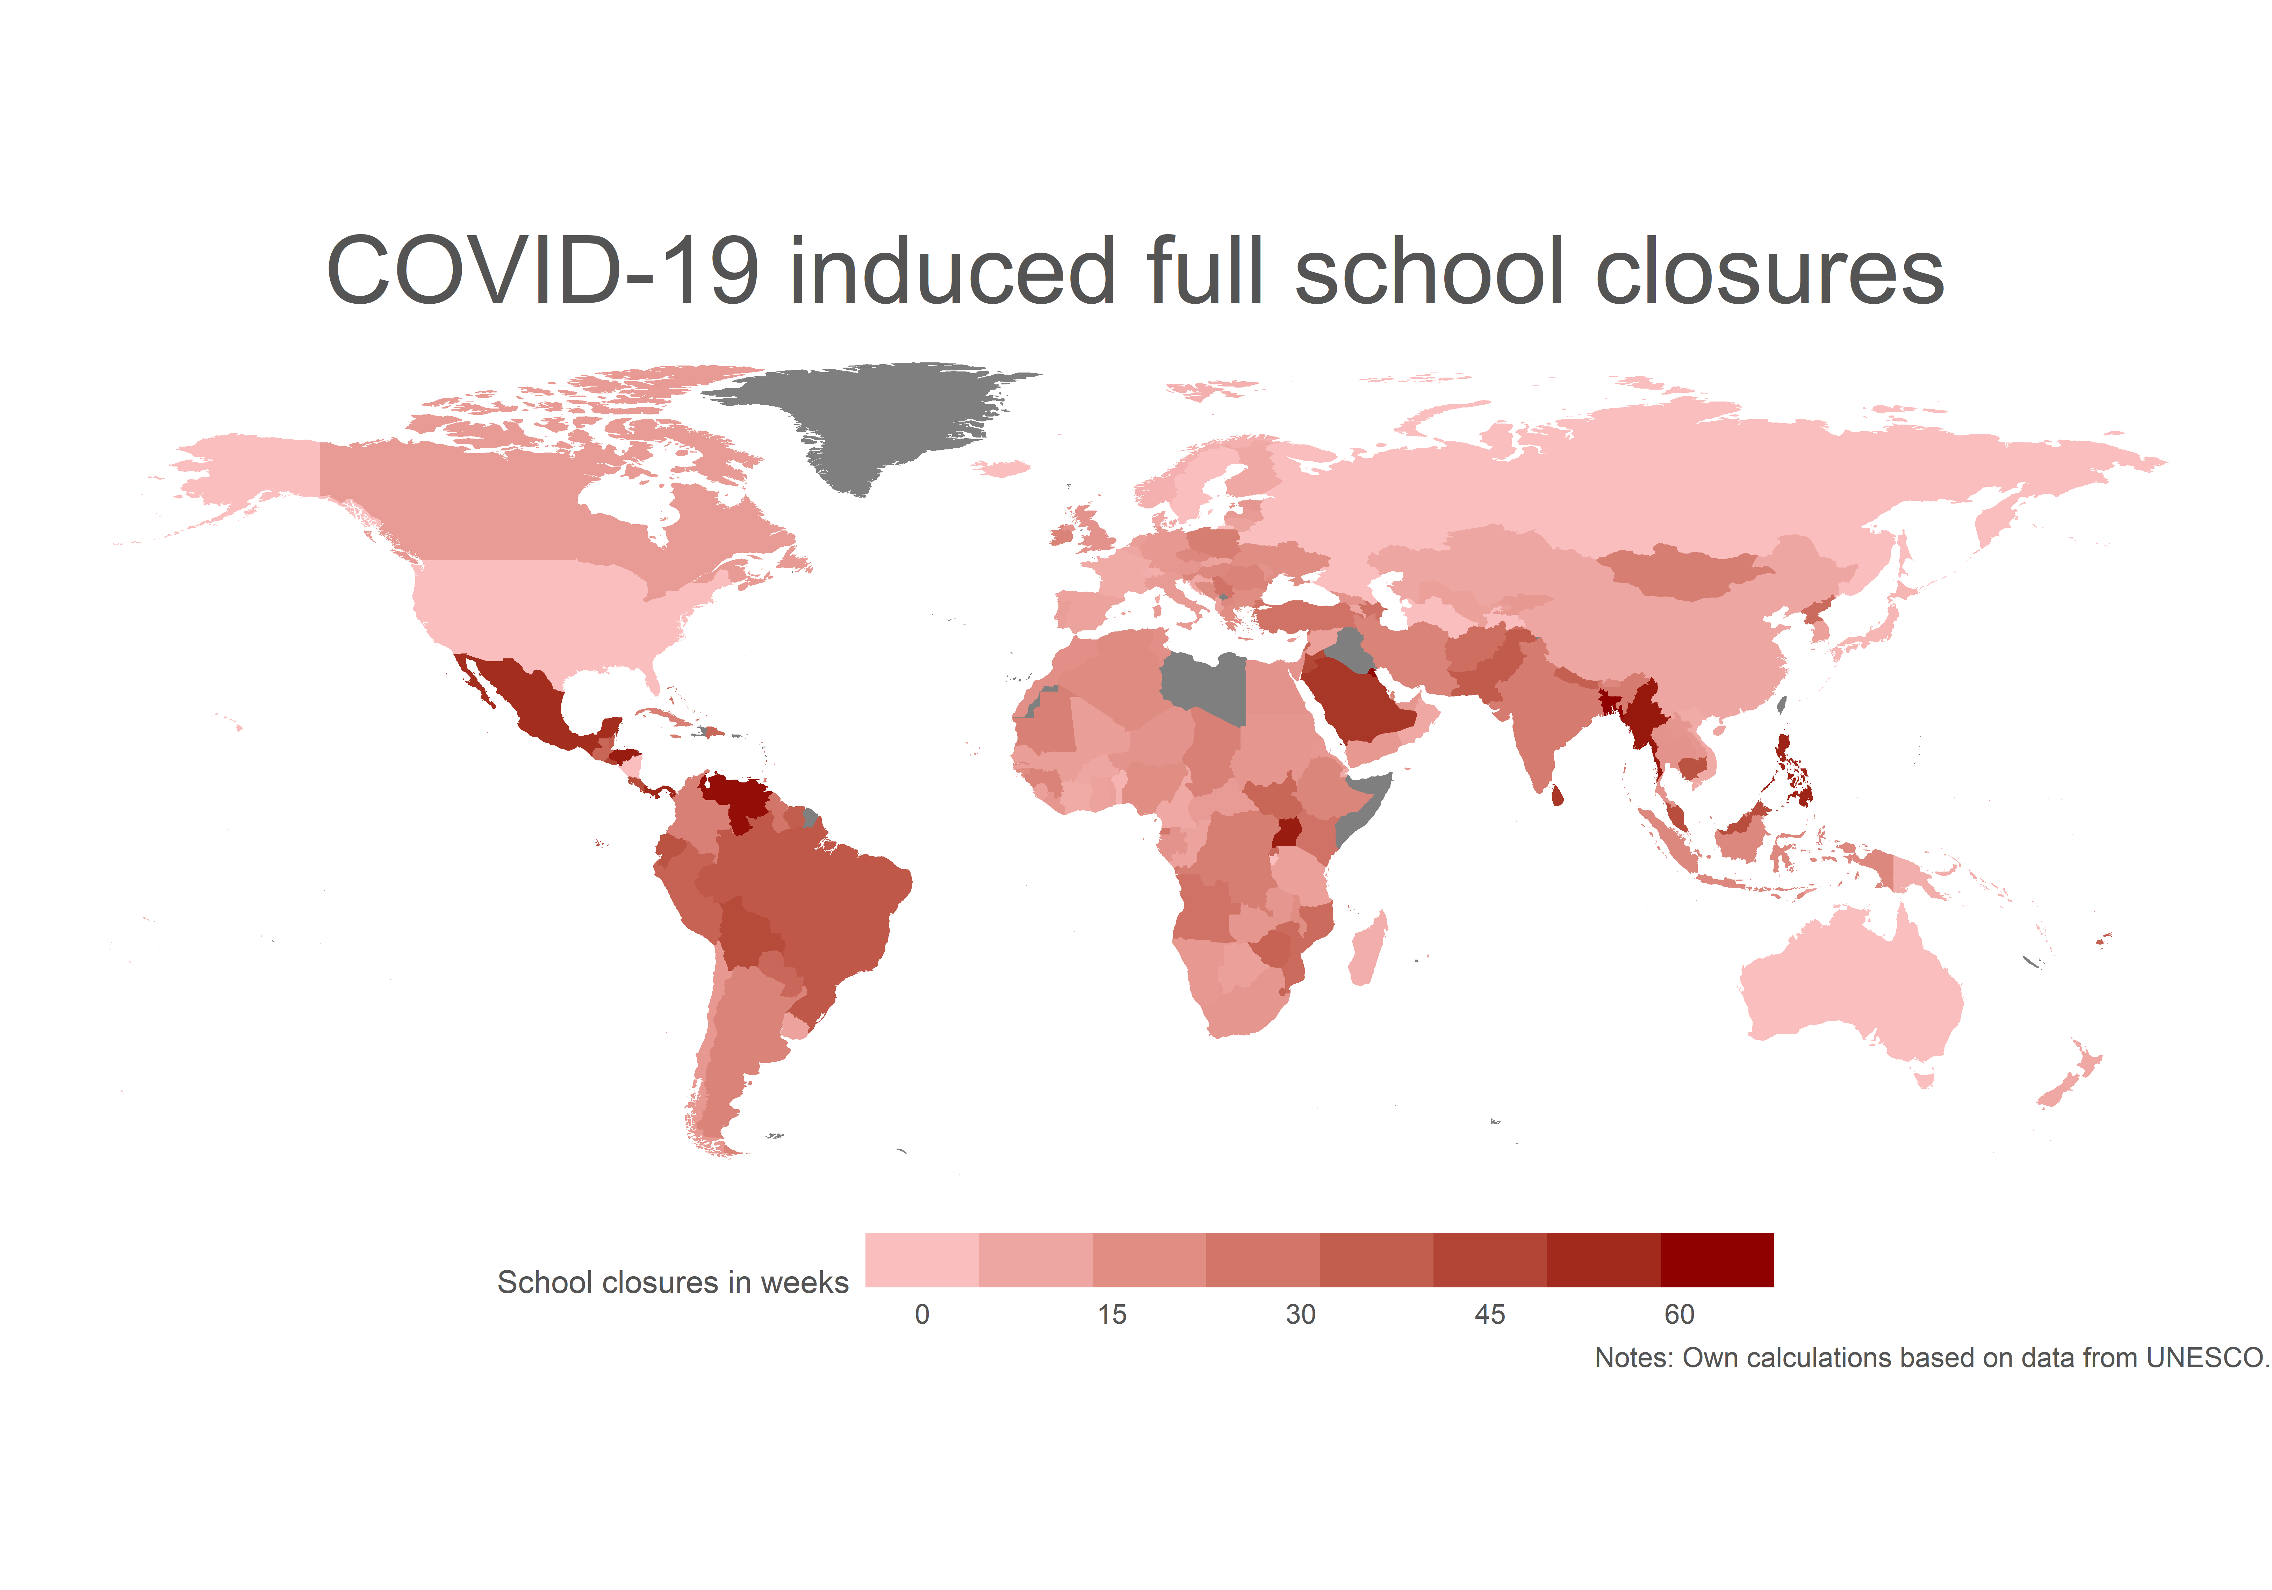
#FFTCONF22

Slide 19
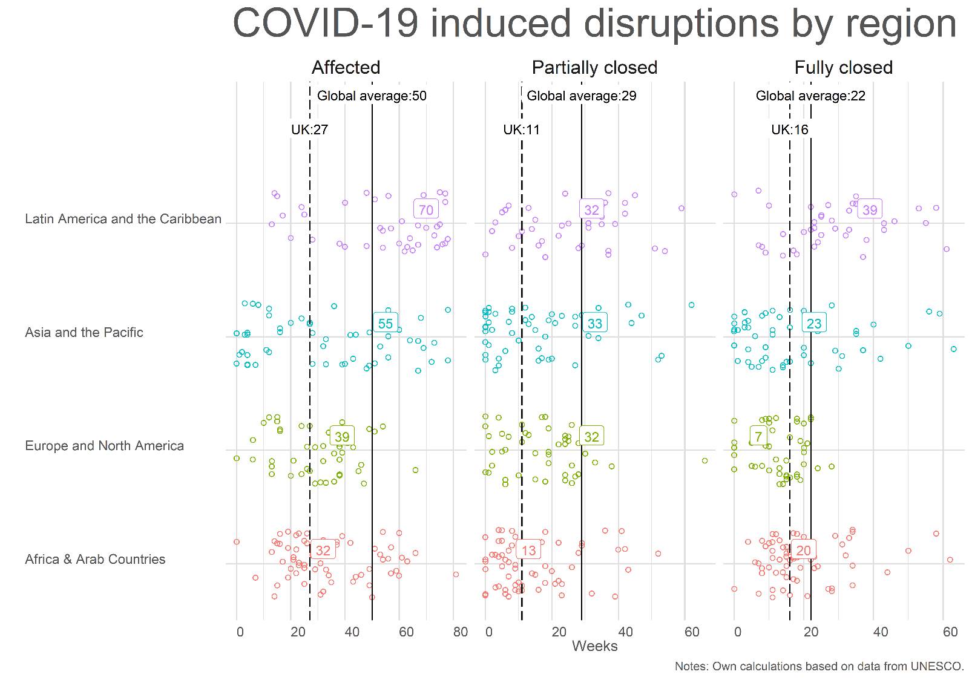
#FFTCONF22

Slide 20
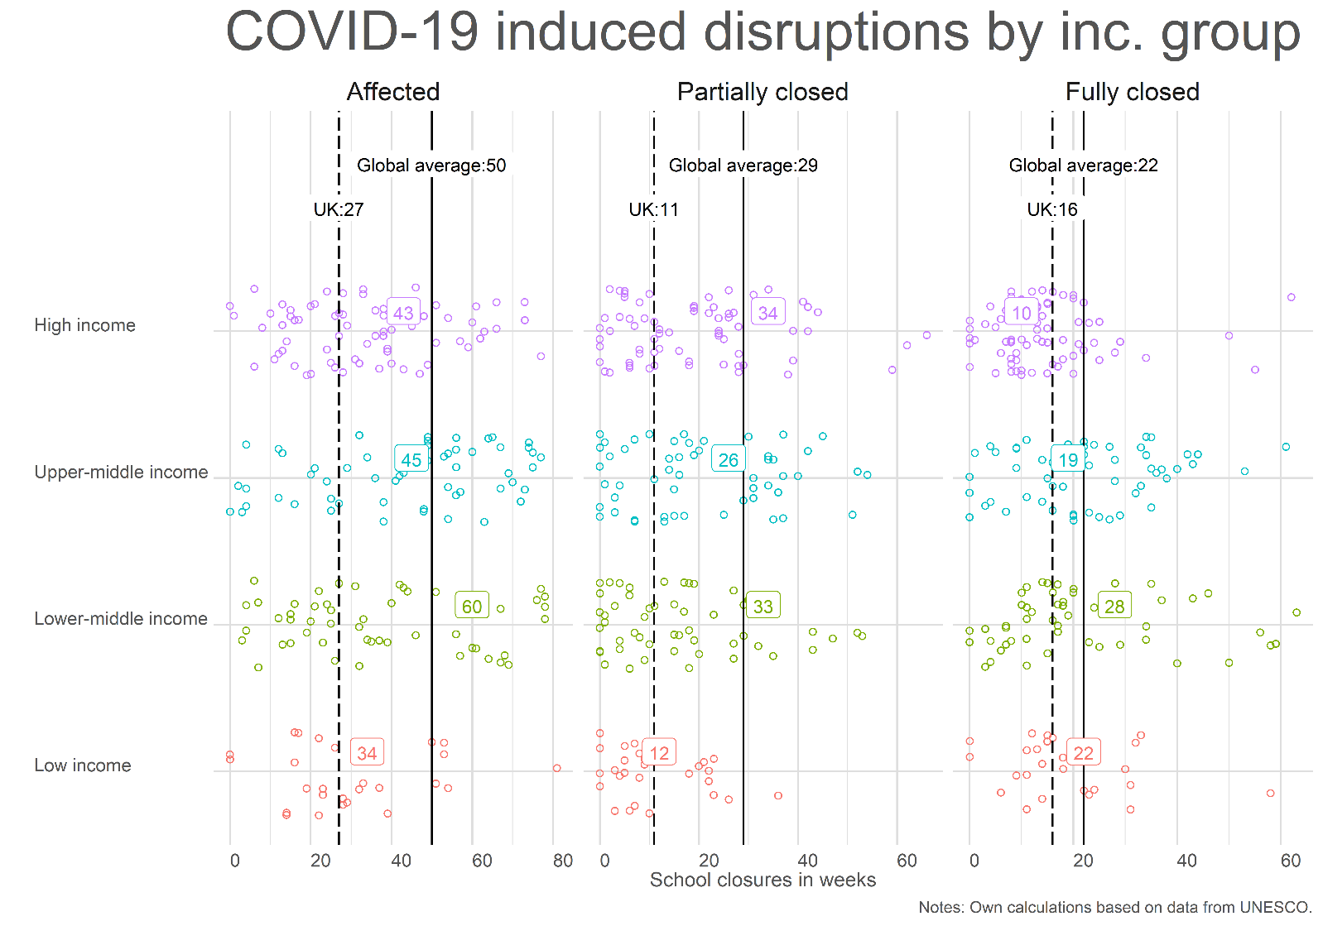
#FFTCONF22

Slide 21
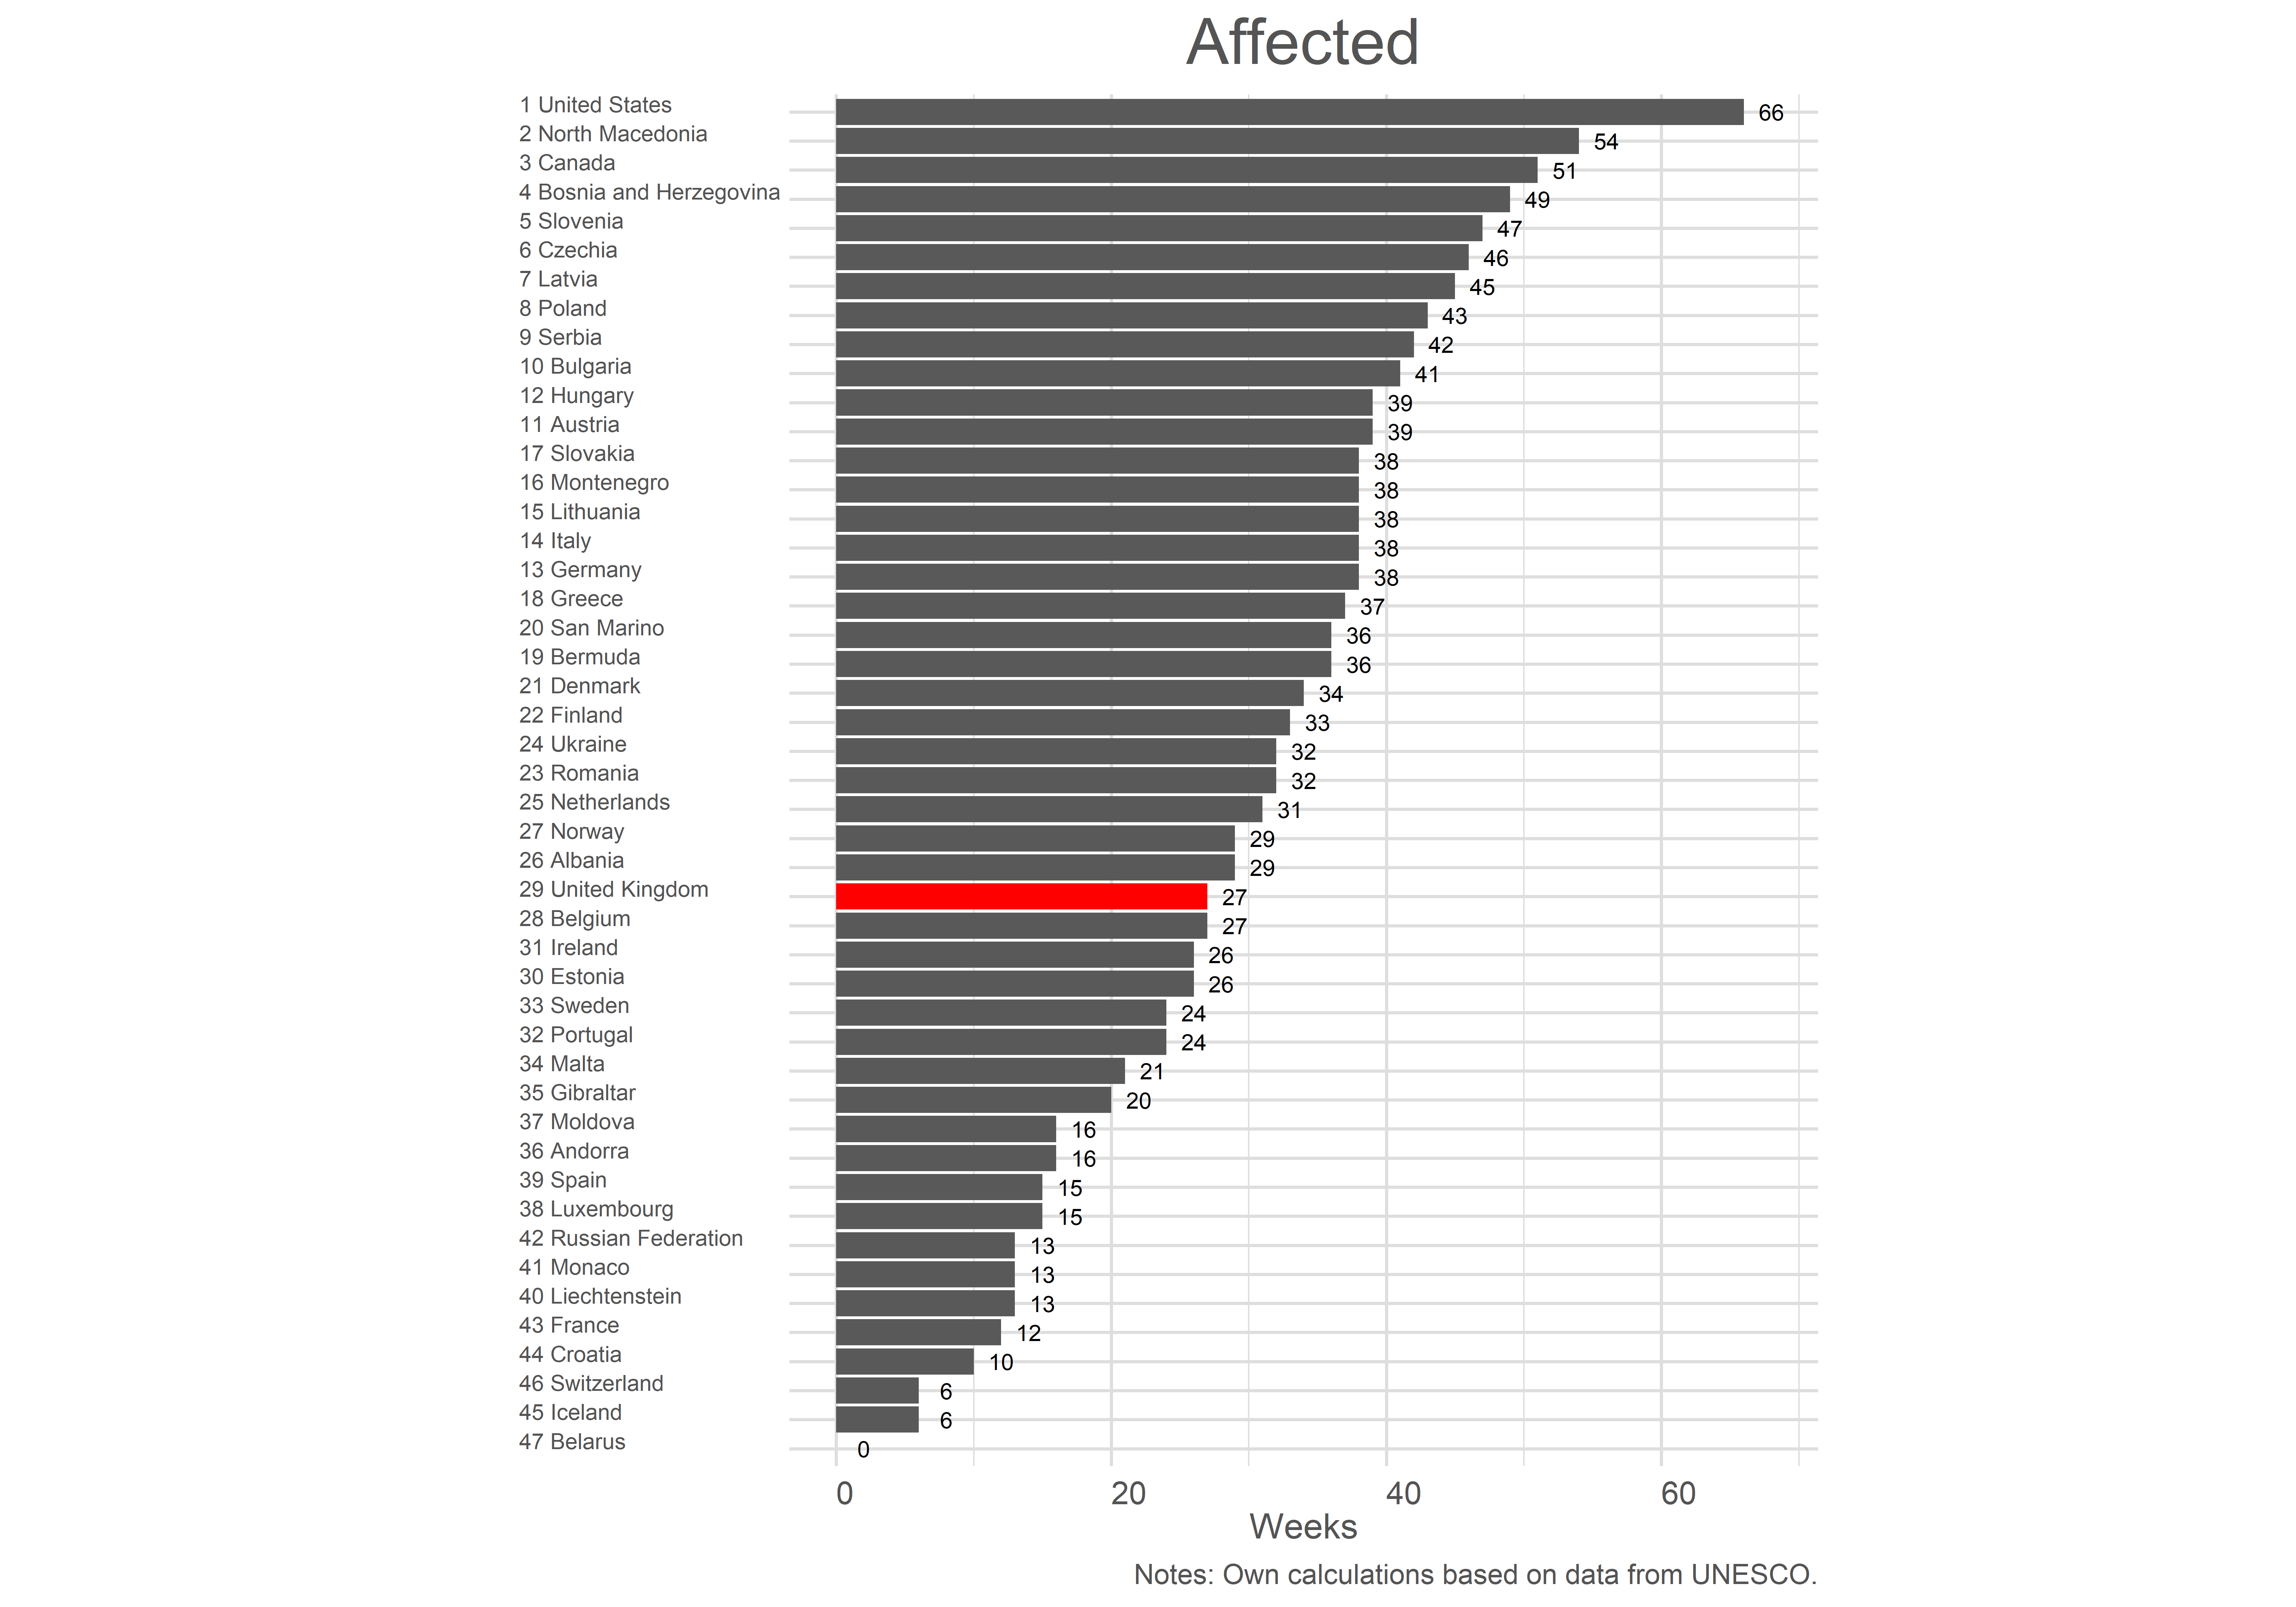
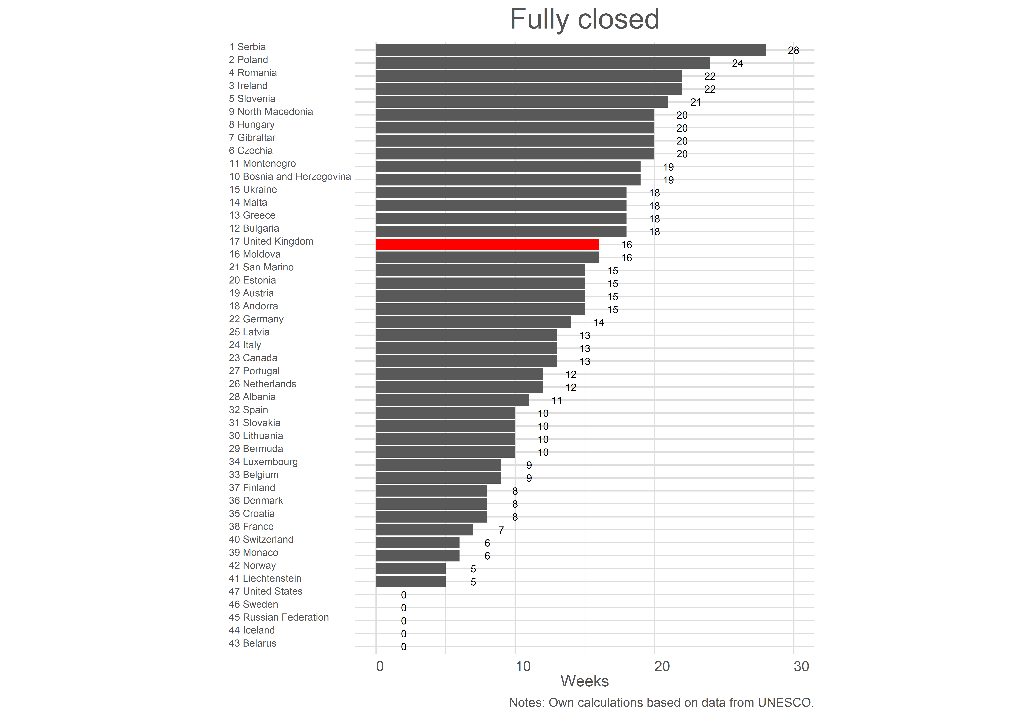
#FFTCONF22

Slide 22
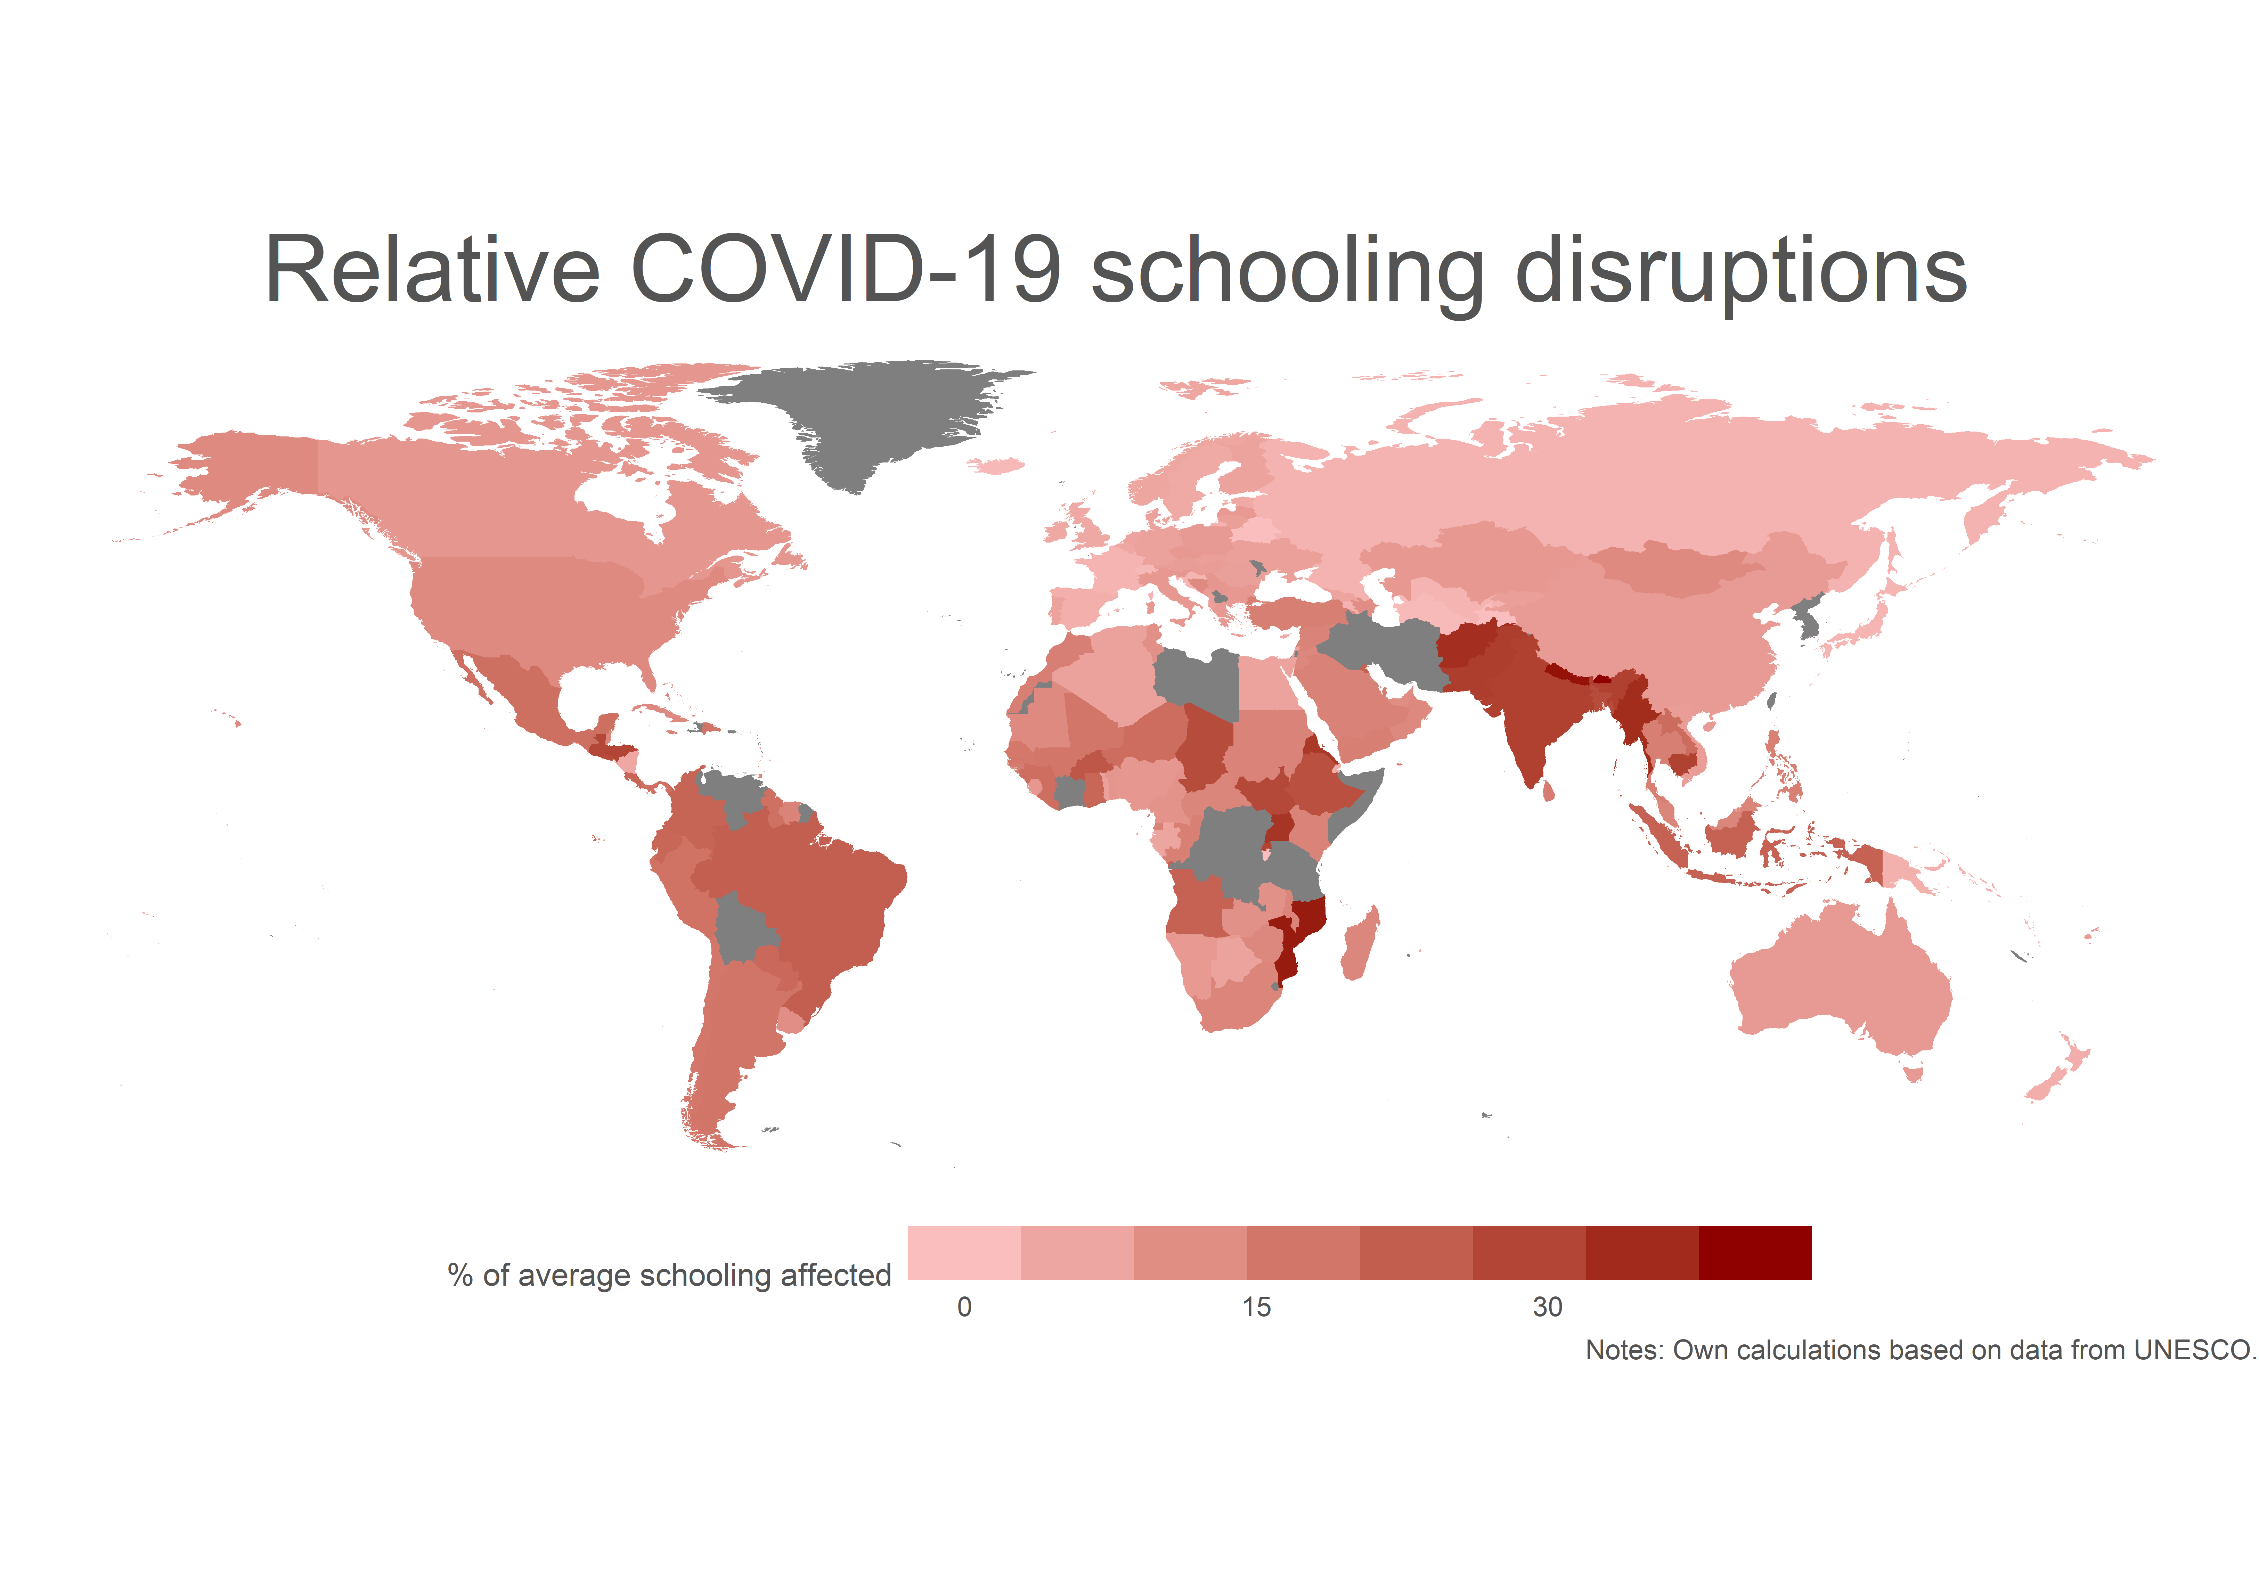
#FFTCONF22

Slide 23
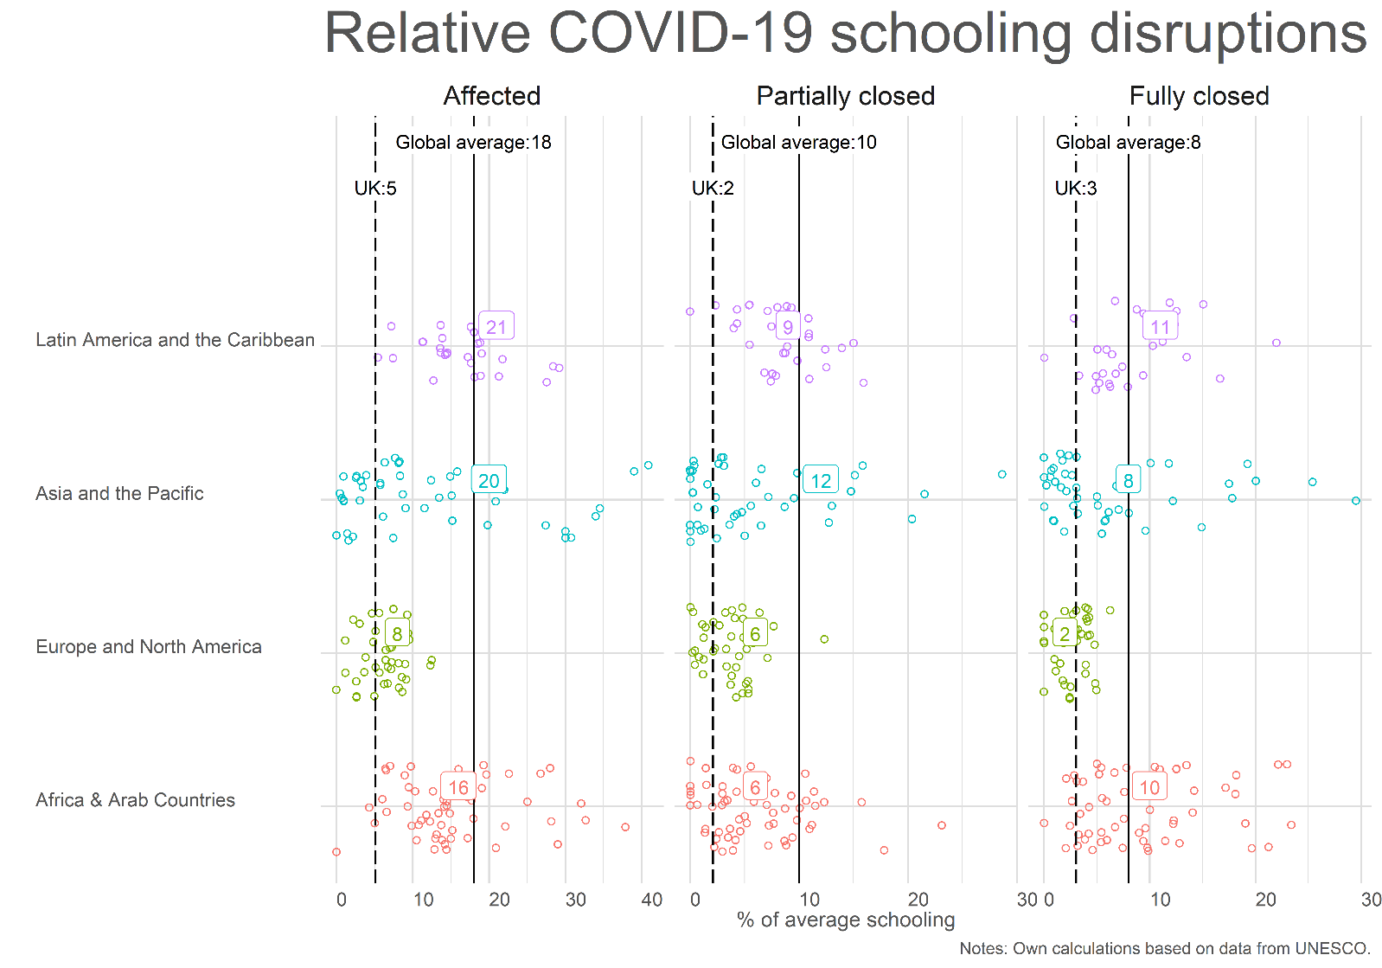
#FFTCONF22

Slide 24
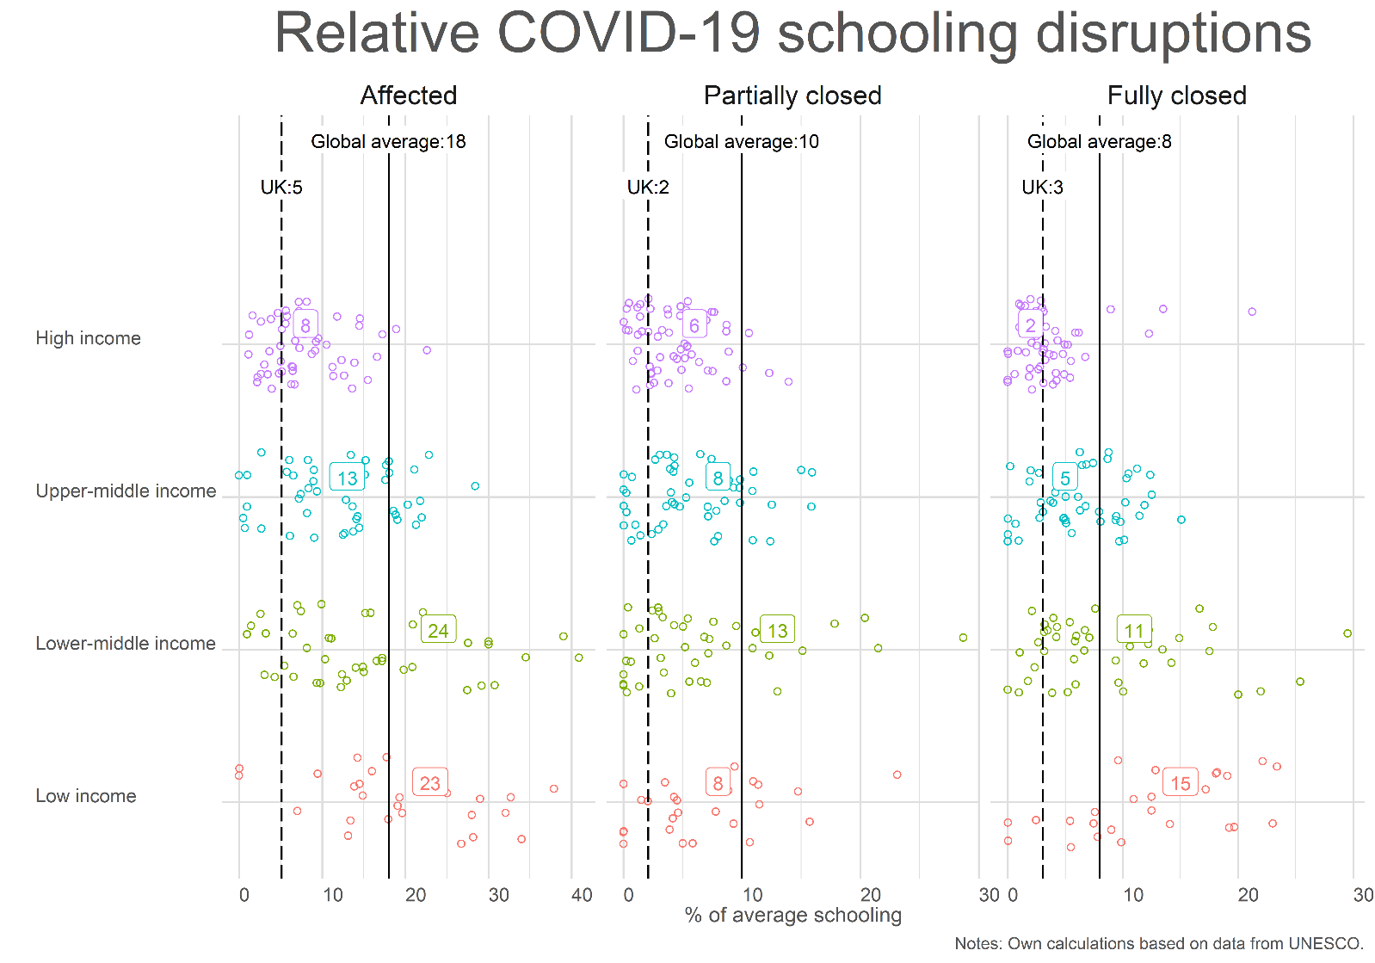
#FFTCONF22

Slide 25
Summary, 21 months into the pandemic
British school children have been affected by 27w of disruptions.
The global average is 50w.
Compared to the average among high income countries, British school children have been less affected (27w vs. 43w).
In terms of full school closures, British children have been more affected than the average in high income countries (16w vs. 10w).
#FFTCONF22

Slide 26
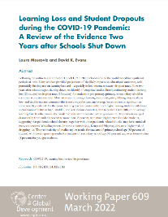
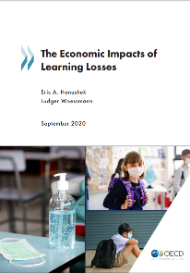
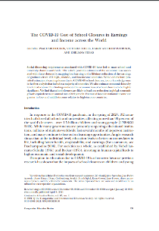
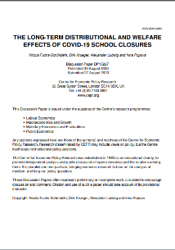
What are the consequences?
Learning loss and increasing dropout rates (Moscoviz and Evans, 2022)
Poor kids are more affected (everywhere)
OECD countries (Hanushek & Woessmann, 2020)
~3% lower lifetime income. (Worse for disadvantaged students.)
1.5% lower annual GDP for the rest of the century
Globally (Psacharopoulos et al, 2021)
“Assuming school closures of 4 months’ duration, our total estimated losses in foregone lifetime earnings for current enrolled students range from US$168–US$364 billion in low-income countries to US$3.2–US$6.9 trillion in middle-income countries, and US$2.3– US$5.0 trillion in high-income countries. The total global losses amount to US$7–US$15 trillion.”
Structural modelling (for the US) Fuchs-Schündeln et al (2020)
“On average (across children aged 4 to 14 when the shock occurs), the model implies an increase in the future share of children without a high school degree of 3.8% and a reduction of the share of children with a college degree of 2.7% when both school closures and the economic recession is taken into account. On average, the earnings losses induced by reduced human capital accumulation and lower educational attainment amount to about −1%”
#FFTCONF22

Slide 27
Thank you for your attention
h.h.sievertsen@bristol.ac.uk
#FFTCONF22

Slide 28



